Slide 1
ALCOHOL DAMAGES ON HUMAN BODY

Slide 2
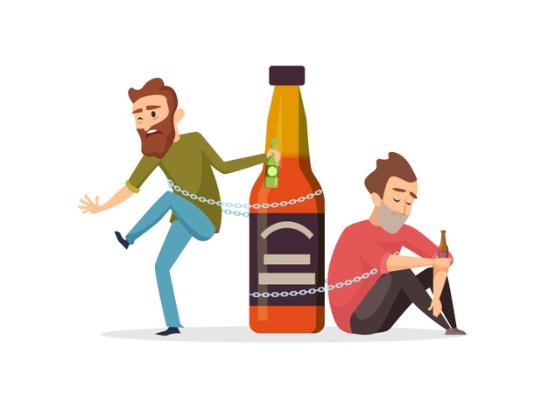
Alcohol: what is it?
Food alcohol (ethyl alcohol), found in alcoholic drinks, is a substance derived from fruit sugar fermentation (wine) or starches contained in cereals (beer) and tubers.

Slide 3
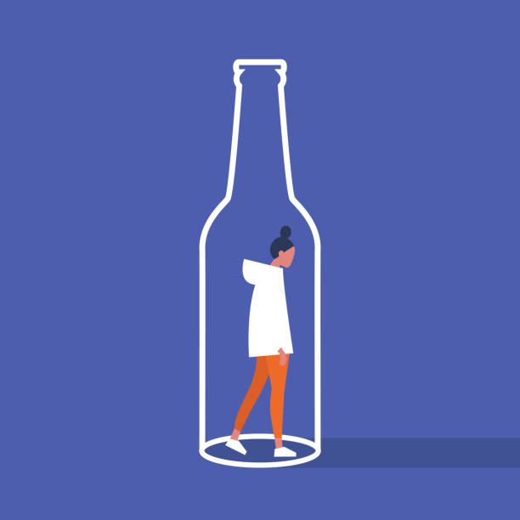
Alcoholism
Adequate alcohol consumption does not imply body damages but any excess can cause addiction and in this case we can talk about alcoholism, a chronic and mortal disease which causes affected people both physical and psychological damages.

Slide 4
Alcoholism causes
The main alcoholism causes are:
Family problems
Alcohol addicted parents
Low self-esteem
Stressful lifestyle
People becoming alcohol addict at an early age are more predisposed to alcohol-derived diseases. According to scientists men are more affected than women.

Slide 5
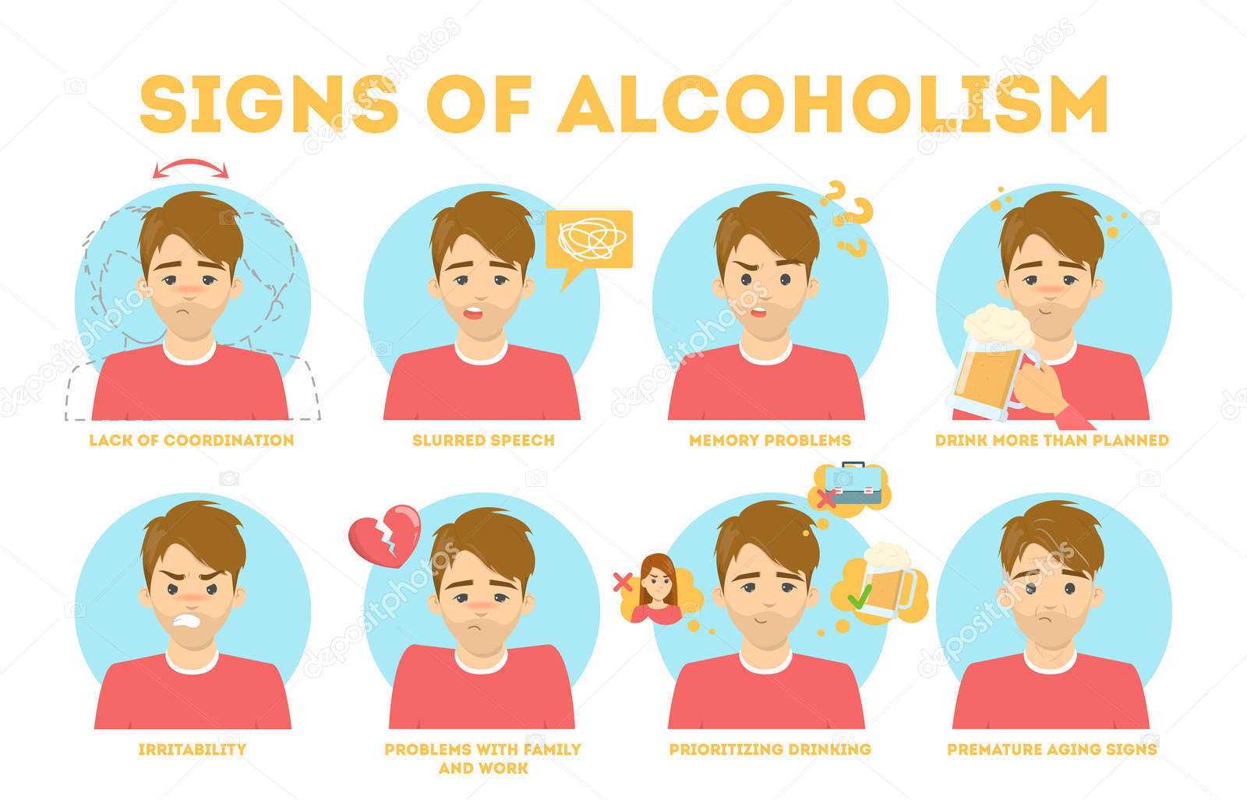
Alcohol symptoms
There are various alcohol addiction symptoms:
Drinking great quantities of alcohol any time of the day
Constant desire of alcohol consumption
Increase in the alcohol quantity consumed

Slide 6
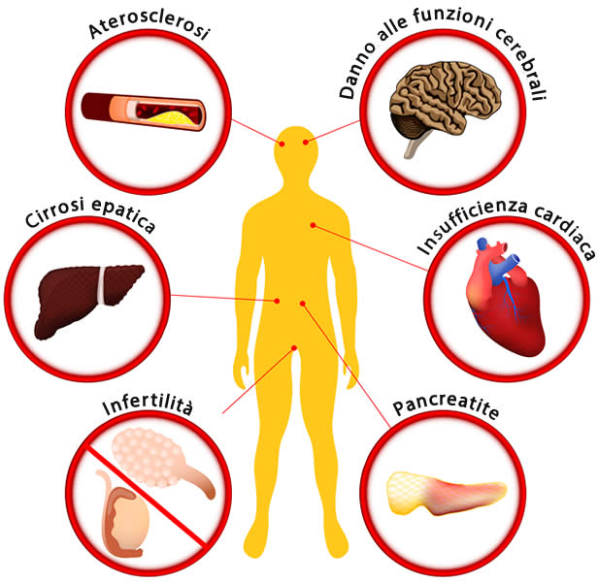
Alcohol damages
They can be divided into physical and psychological damages. An alcohol addicted subject has an average life expectancy 12 years lower than a healthy one. 40-50% of murders, 40% of aggressions and 50% of rapes are due to alcohol abuse.

Slide 7
Physical damages
Alcohol can cause great damages to the liver:
Hepatic steatosis, a usually asymptomatic condition which can change if the subject stops drinking.
Alcohol hepatitis, shown if the subject affected by steatosis goes on drinking until the liver functionality is affected.
Cirrhosis
Fibrosis, shown when epatitis is overlooked.
Heart and vascular problems

Slide 8
Psychological damages
Alcohol can modify the nervous system structure. It can also cause psychiatric problems (depression, paranoia, food disorders) and mental problems (raves, hallucinations).
.

