Slide 1
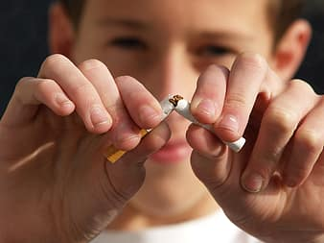
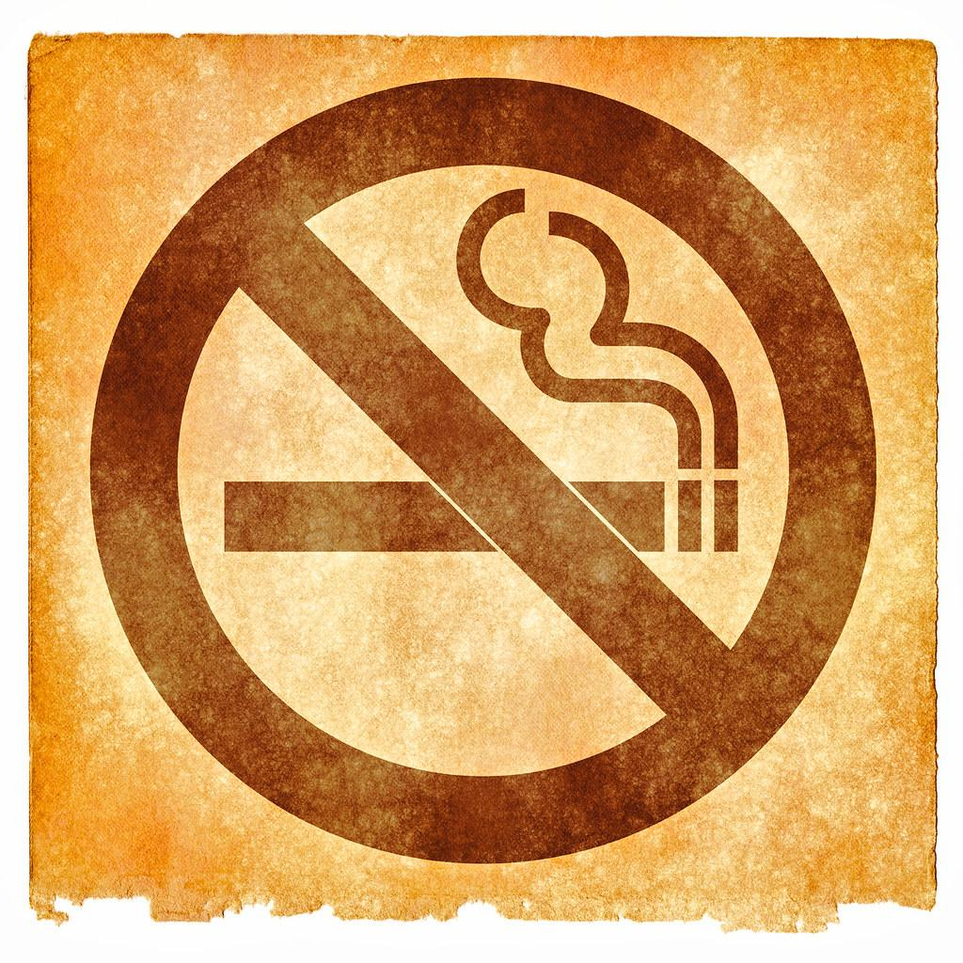
NO JOKING WITH SMOKING!

Slide 2
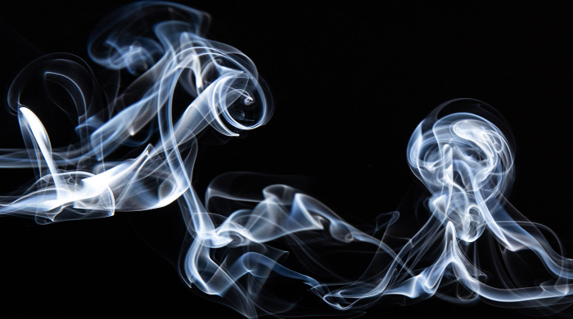
SMOKING EFFECTS ON OUR HEALTH
The harmfulness of tobacco is due to its chemical composition; when it burns it produces about 4000 substances, of which at least 40 are very toxic.
The harmful substances responsible for damage to the circulatory system are mainly CARBON MONOXIDE and NICOTINE
Ripercussion on the Nervous System
Widespread feeling of well-being
Reduction of nervous tension
and anxious state

Slide 3
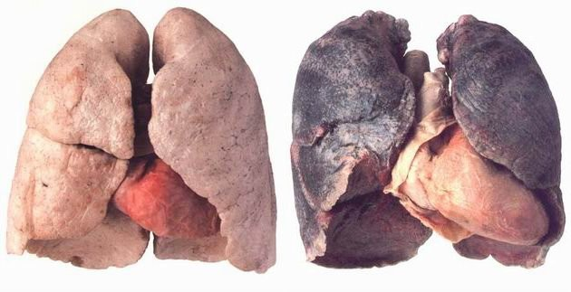
SMOKING RELATED DISEASES
Asthma
Cancer
Lung disease
Lung
Stomach
Kidney
Esophagus
Oral cavities
Chronic heart disease

Slide 4
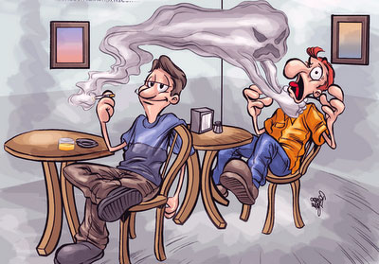
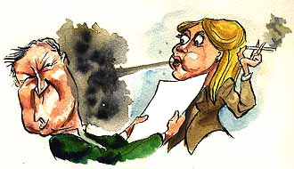
PASSIVE AND ACTIVE SMOKING
Passive Smoking
Is the involuntary inhalation of smoke
from a smoker's cigarette
Active Smoking
Is the smoke inhalation of a cigarette by the smoker

Slide 5
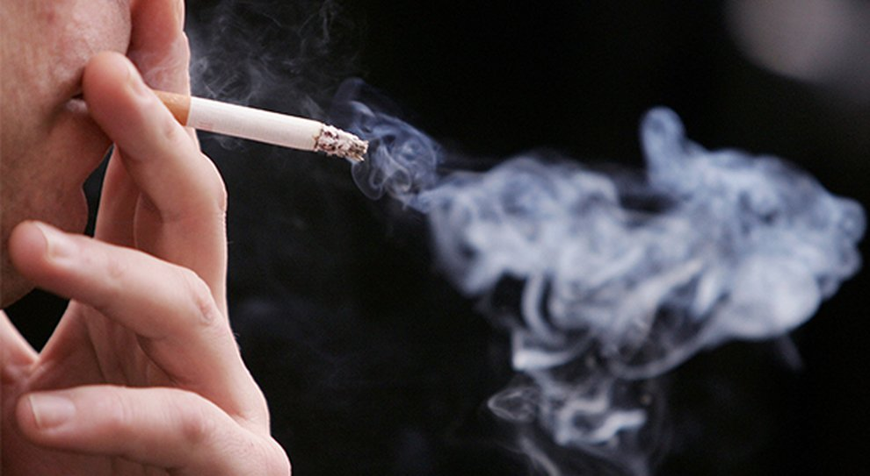
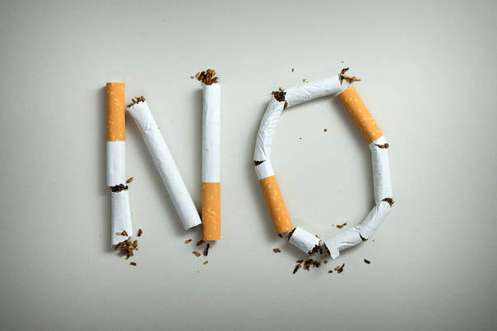
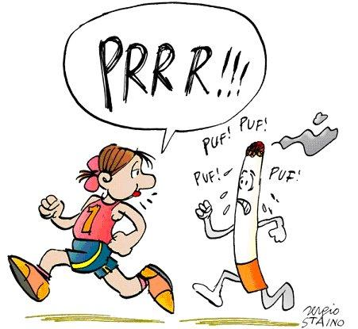
Smoking is bad for our health!
DEMAGES OF SMOKE
Run away from this bad habit!

Slide 6
